Slide 1
Army Reserve Officer Training Corps (ROTC) United States Army Cadet Command

Slide 2
What is Army ROTC?
Largest officer generating PROGRAM- Produces over 60% of Army Officers, currently 20,000 students are enrolled
273 programs nationwide, including Puerto Rico and the Virgin Islands
ROTC offers the same professional opportunities as WEST POINT.

Slide 3
ARMY ROTC
College Senior ROTC participation DOES NOT require High School Junior ROTC participation
You may take Army ROTC in college without any obligation for first two years
Program develops Officers for the US Army

Slide 4
OFFICERSHIP
Army ROTC is one of the most demanding and successful leadership programs in the country, creating leaders who go on to rewarding careers in the military as Officers and civilian worlds.
Benefits of Army ROTC include:
High-level leadership, management and communications training
Problem solving and strategic skills development
Scholarships and monthly stipends
Upward economic and career mobility
Professionally rewarding careers for diverse academic majors and skill sets
Service to the nation is an honorable and prestigious career
Army Officer leadership development and skills learned gives young people a competitive advantage

Slide 5
Prominent Army ROTC Alumni
Colin Powell
Former Sec of State and Chairman of the Joint Chiefs of Staff
Samuel Alito
Associate Justice of the Supreme Court
Samuel Walton
Founder of WALMART
Lenny Wilkins
Most wins as NBA coach

Slide 6
Candidate Qualifications Examples
Scholar
Excellent grades and test scores
National Honor Society member
Athlete
-Varsity letter in HS
-Active involvement in sports
-Physically Fit
Leader
-Elected member of student government
-Captain of athletic or academic team
-Leadership in any organization/Scouts/Church/School

Slide 7
High School Scholarship Application Process
Application deadlines (On-line at www.armyrotc.com)
Spring of junior year – earliest you can apply
Three boards meet in your senior year
President’s Challenge Physical Fitness Test/APFT
Department of Defense (DODMERB) Physical
Interview with ROTC Professor of Military Science
University admissions process is independent of scholarship process

Slide 8
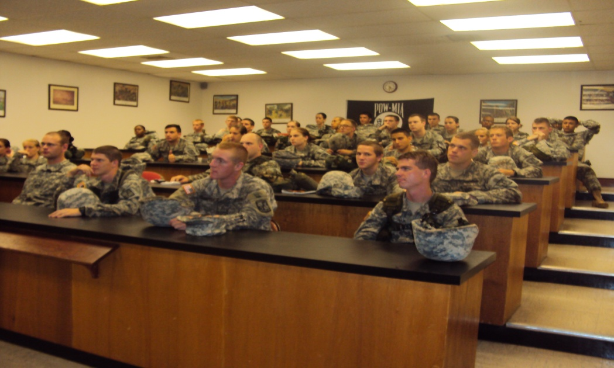
High School Scholarship Application Process
Typically 2000 scholarships per year offered
If you do not receive an offer, can still take ROTC
Army Nursing Scholarships Available
Science and Engineers Scholarships
Scholarships available on campus

Slide 9
High School Scholarship is NOT your last chance to be an officer
Scholarships are available on-campus:
3 year campus based scholarships
2 year campus based scholarships
Reserve Forces Duty Scholarships
Leader Training Course (LTC) Scholarships (provides MS-1 Freshman and MS-2 Sophomore credit)

Slide 10
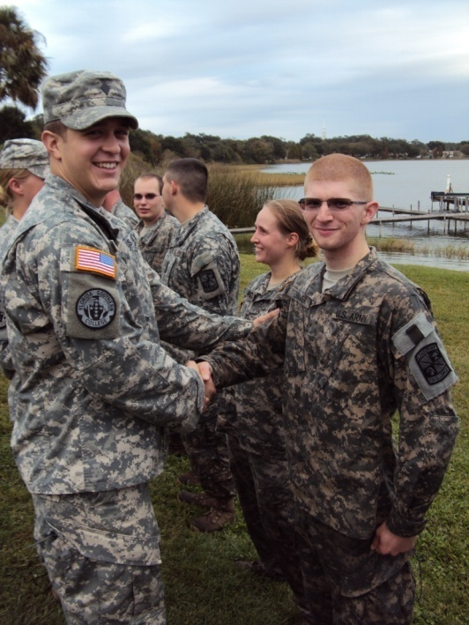
Army ROTC Scholarships
Pays full tuition and fees OR room and board
$1200 a year book payment
($600 per semester)
Cadet Stipend $300, $350,
$450, $500 monthly
Some ROTC programs offer additional incentives such as free room and board scholarships (typically private colleges)

Slide 11
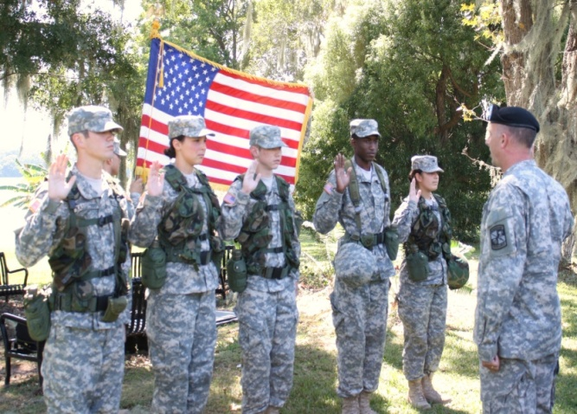
General ROTC Eligibility to become Officer
U.S. Citizen
Qualified Medical Examination
Ages 18-27
Good moral character
Pass the Army Physical Fitness Test
Meet the height/weight requirements
Full time student pursuing a bachelor's or master’s degree
Approved by the Professor of Military Science

Slide 12
Opportunities
Competitive Salaries
In the Army you garner:
The appreciation of our Nation
A competitive salary
World-wide travel and assignments
100% Medical and Dental coverage
30 days paid vacation annually
Unmatched life insurance
Transferable education benefits
Civilian transition assistance
World-class family services
Highly coveted civilian skills
Rank | Years of Service | Annual Pay
Lieutenant | 2 | $62,095
Captain | 6 | $82,951
Major | 16 | $107,824
Lieutenant Colonel | 20 | $122,797
Colonel | 24 | $142,489
Pay source is http://militarypay.defense.gov/mpcalcs/Calculators/RMC.aspx using avg housing allowance
Notes:
- Military service continues to be a respectable and needed means for giving back to one’s country. Just watch the public support our Soldiers receive as they go through airports in uniform.
-As you can see on the table on the right, pay raises designed to ensure the viability of the All-Volunteer Force have resulted in very competitive wages for commissioned officer service. These figures do not include a tax-free housing allowance based on location and rank.
- In fact, officership offers immediate attainment of middle class status.
- Officers continue to have opportunities to travel and move often to a variety of world- wide locations.
- Generous retirement. 50% of base pay at 20 years of service, rising 2.5% to 75% at 30 years. Annual cost of living allowance raises tied to inflation make it the gift that keeps on giving.
- Service member’s Group Life Insurance (SGLI). All Service Members entitled to $400,000 benefit are automatically insured for the maximum amount of $400,000 for $27/month.
- The new Post-9/11 GI Bill offers up to 100% tuition and fee coverage as well as monthly housing stipend. The Bill also offers a new twist— you have the option of passing on your benefits to your spouse or children.
- The leader training and opportunities you receive will be valuable experience that will hold you in good stead for any career option you pursue following military service.
- According to headhunters, human resources executives, and business school admissions officers, junior officers, with a college degree and leadership experience far beyond that of their civilian peers- are stars waiting to happen.

Slide 13
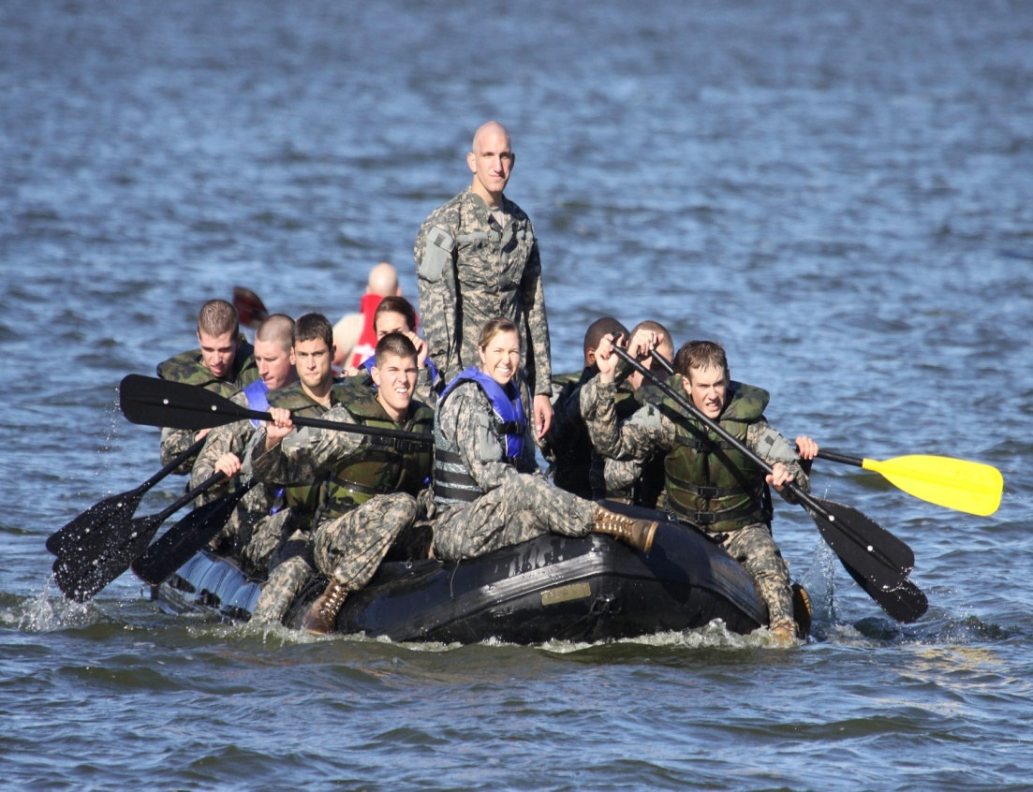
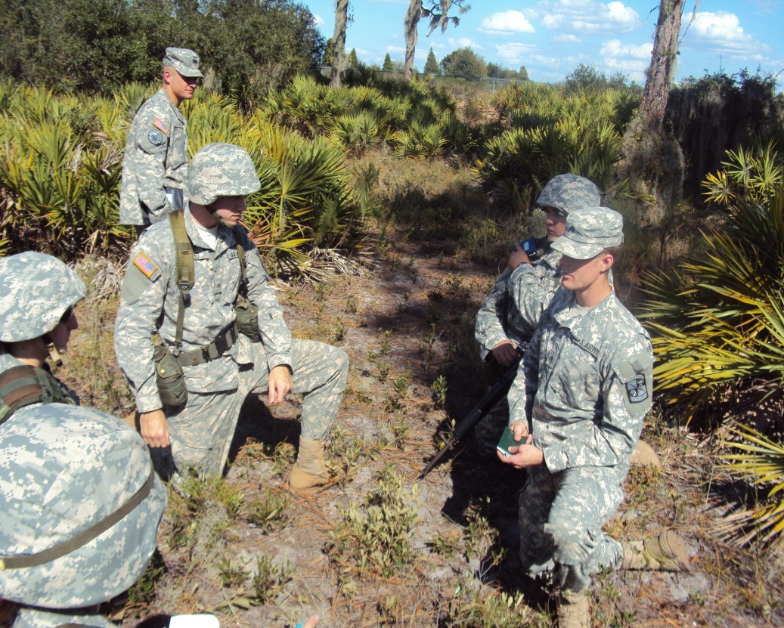
Questions?
For more Information go to http://www.goarmy.com/rotc/
or contact nearest College Army ROTC Recruiting Officer

